Slide 1


INTERIOR ARCHITECTURE & BESPOKE FURNISHING PROPOSAL
PECANWOOD ESTATE
WHERE LUXURY BEGINS AND NEVER ENDS....

Slide 2

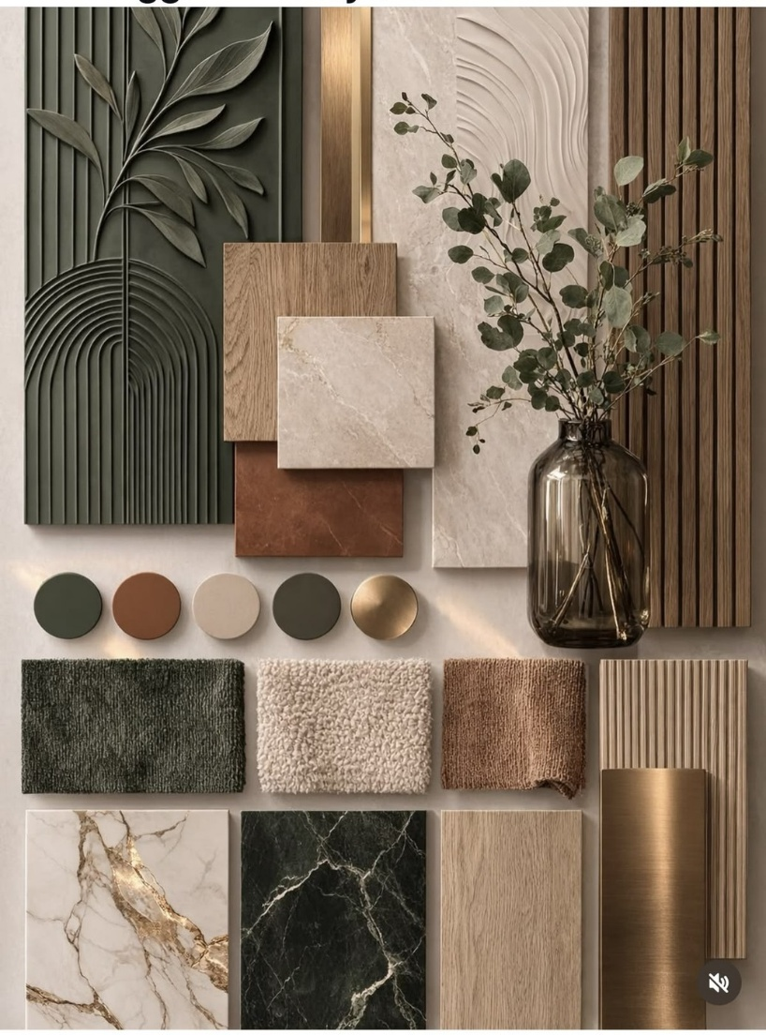
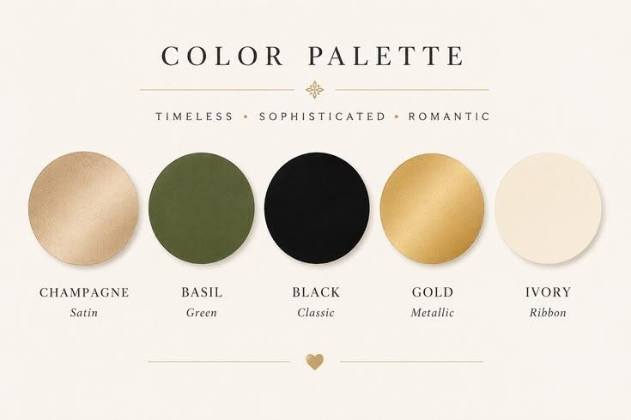

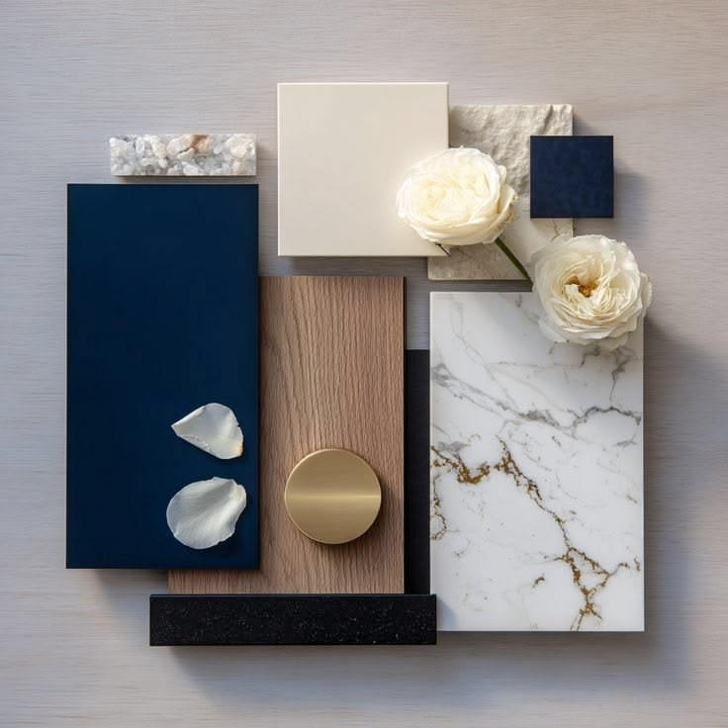
SLIDE 02 / FOUNDATION & TONE
COLOUR PALETTE
TIMELESS | SOPHISTICATED | ORGANIC TEXTURES & METALLIC ACCENTS
SIGNATURE COLOUR STORY
Champagne, Basil, Black, Gold, Ivory
PRIMARY MATERIALITY
Basil Green, Travertine & Brass
COMPLEMENTARY FINISHES
Calacatta Veining & Walnut
WARMTH & CONTRAST
Cognac & Terracotta Undertones

Slide 3

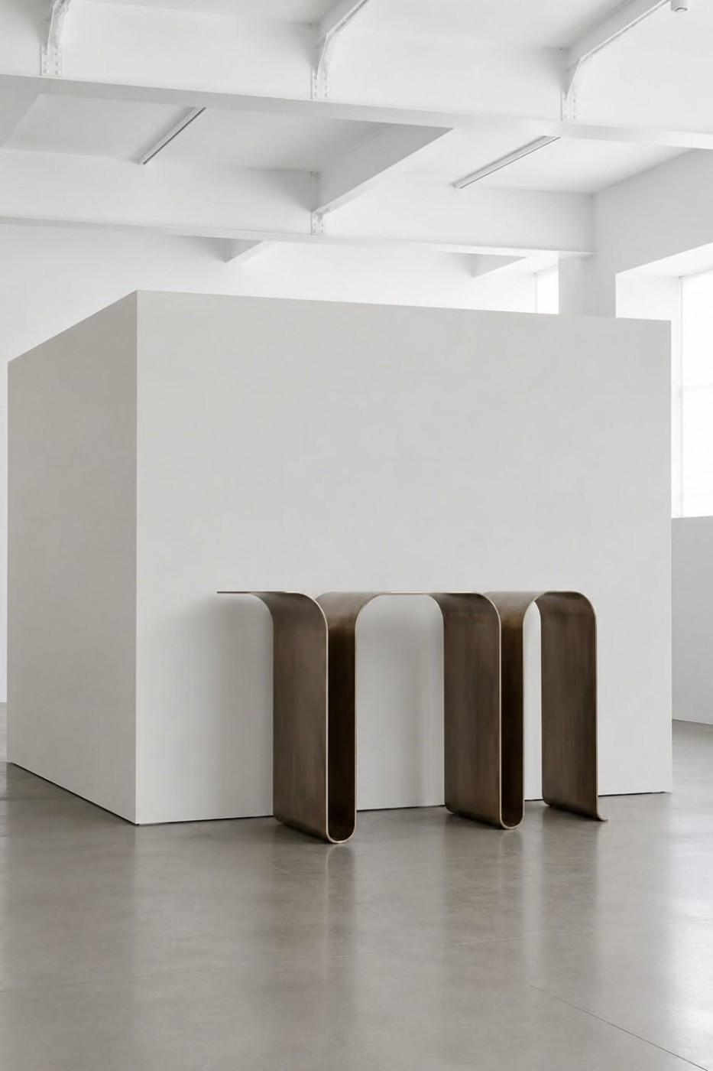
SLIDE 03 / ARRIVAL EXPERIENCE
ENTRANCE WALL
SCULPTURAL BRUSHED BRONZE CONSOLE TABLE
SCULPTURAL RIBBON CONSOLE
Continuous Brushed Bronze Silhouette

Slide 4

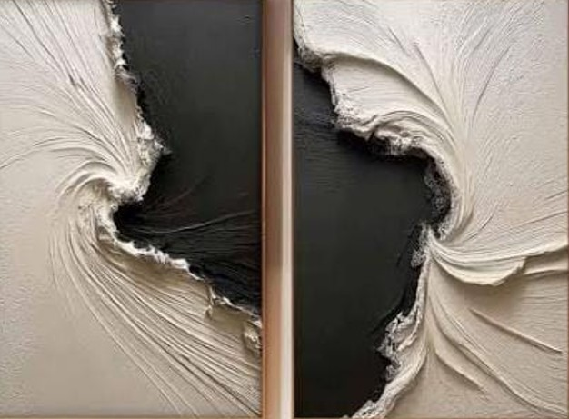
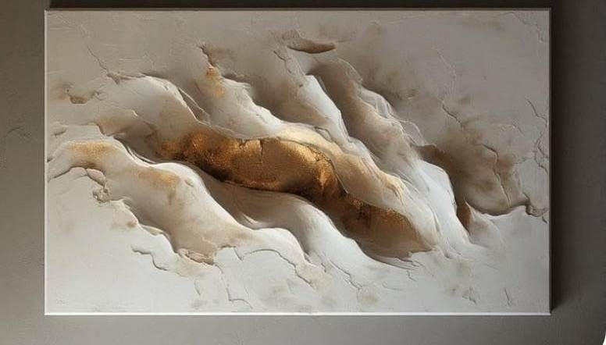
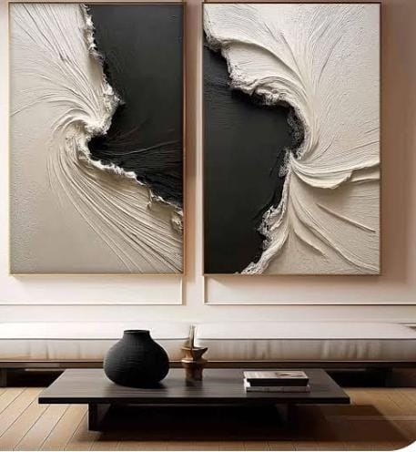
SLIDE 04 / ARRIVAL EXPERIENCE
ENTRANCE WALL
ABSTRACT ART WORK | 1.5M X 1M | ABOVE CONSOLE
SCULPTED DIPTYCH
Ivory & Charcoal Relief
ABSTRACT ART WORK (1.5M X 1M)
Positioned Above Console
ABOVE CONSOLE ELEVATION
Scale Reference Above Console

Slide 5

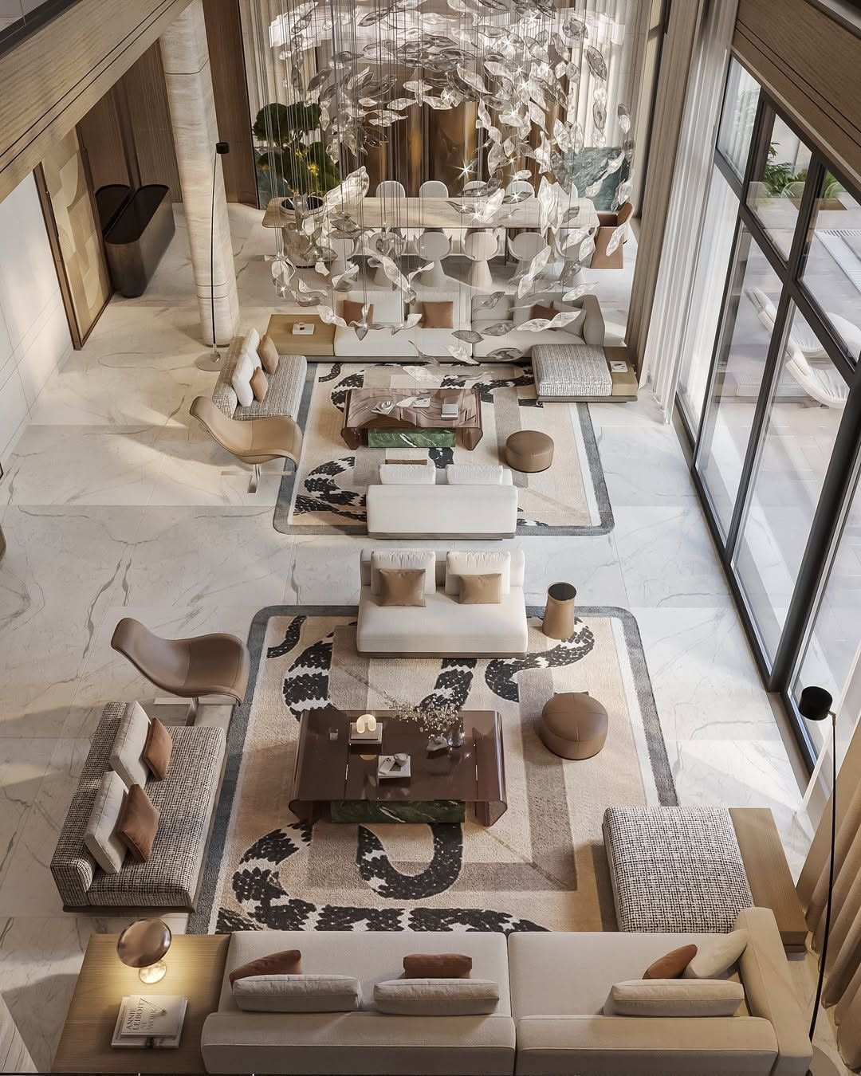
SLIDE 05 / SPATIAL ATMOSPHERE
INSPO IMAGE
ARCHITECTURAL INSPIRATION & TEXTURAL DIRECTION
INSPO IMAGE
Open-Plan Luxury Living & Layered Neutrals

Slide 6

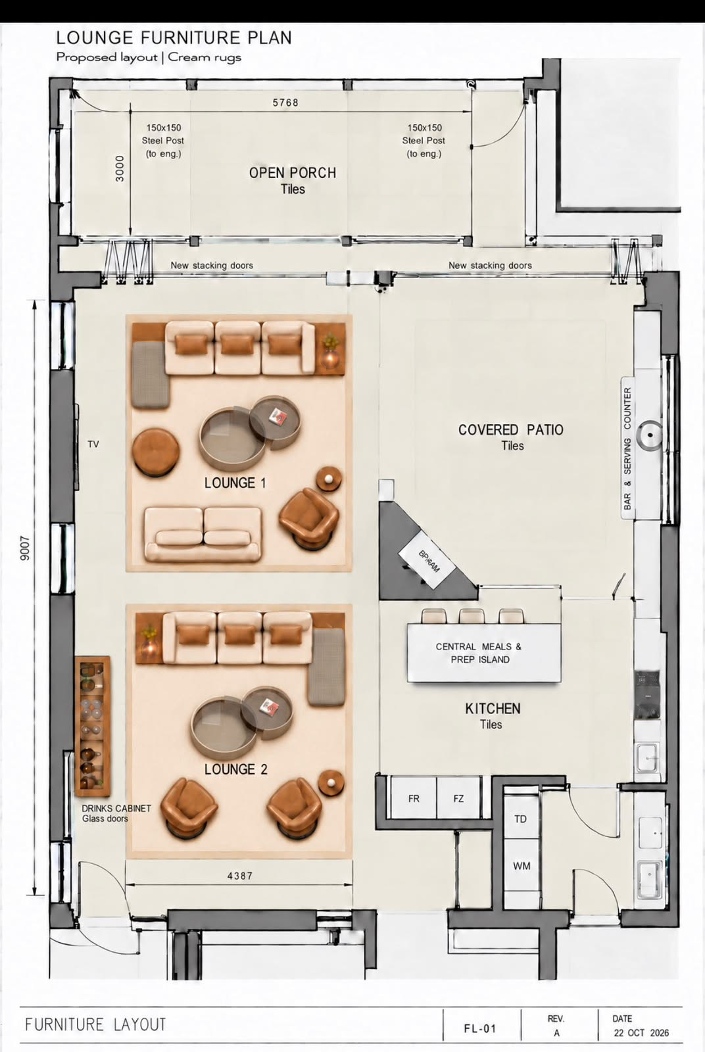
SLIDE 06 / SPATIAL PLANNING
PROPOSED LAYOUT ENTRANCE LOUNGE AND TV LOUNGE
ENTRANCE LOUNGE | TV LOUNGE
PROPOSED FURNITURE LAYOUT
Entrance Lounge & TV Lounge Zoning

Slide 7

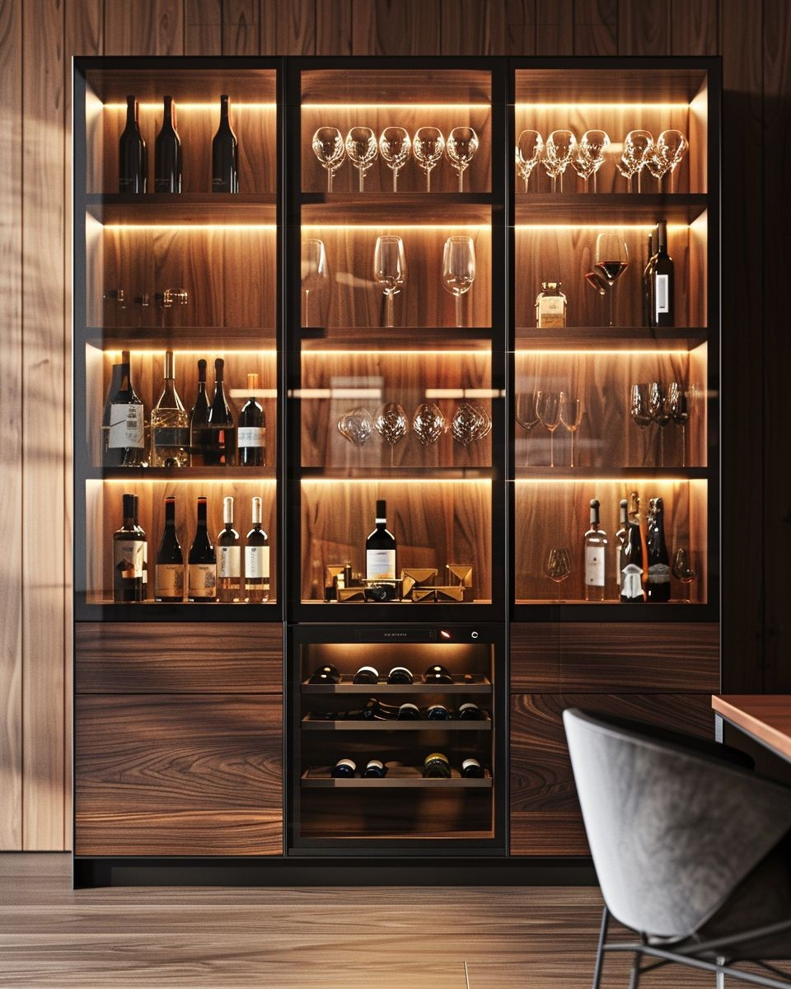
SLIDE 07 / ENTRANCE LOUNGE
ENTRANCE LOUNGE
ILLUMINATED WALNUT DISPLAY & WINE CABINETRY
BESPOKE DISPLAY & WINE CABINETRY
Warm LED Backlighting, Fluted Glass & Walnut

Slide 8

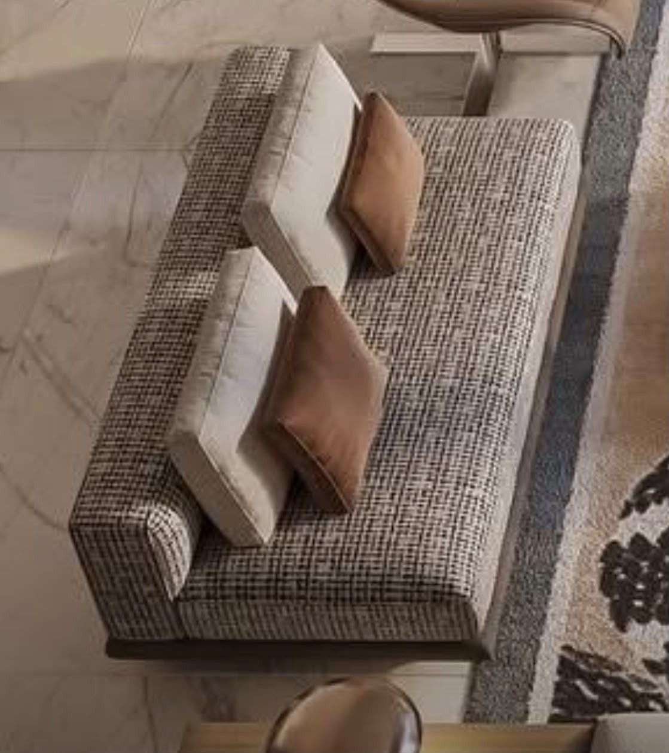
SLIDE 08 / ENTRANCE LOUNGE
ENTRANCE LOUNGE
PRIMARY UPHOLSTERED LOUNGE SEATING
ENTRANCE LOUNGE SOFA
Tailored Multi-Tone Boucle Weave with Cognac & Ivory Cushions

Slide 9

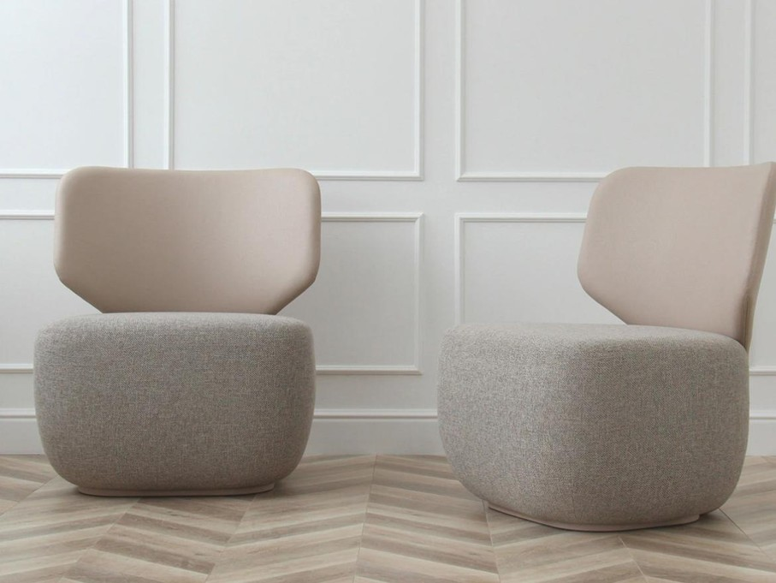
SLIDE 09 / ENTRANCE LOUNGE
ENTRANCE LOUNGE
CURVED SWIVEL OCCASIONAL SEATING
2X SCULPTURAL OCCASIONAL CHAIRS
Two-Tone Boucle Base & Contoured Backrest

Slide 10

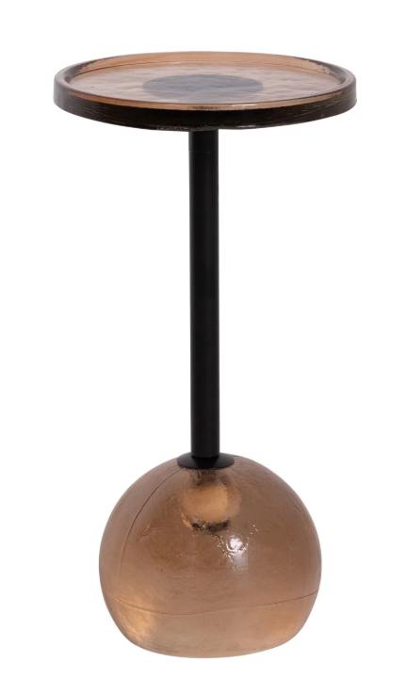
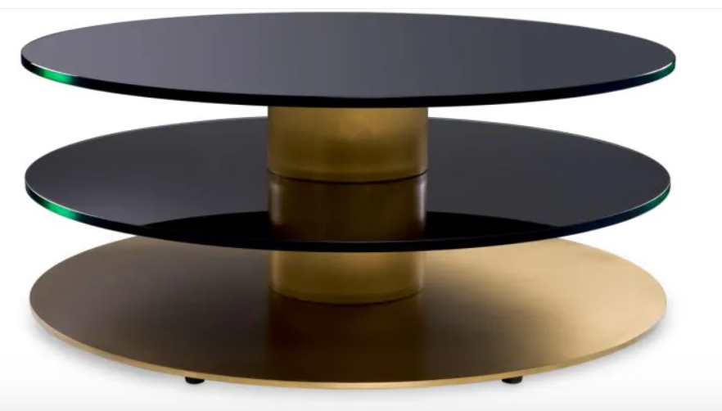
SLIDE 10 / ENTRANCE LOUNGE
ENTRANCE LOUNGE
TOP 2 TIERS BRONZE GLASS | PEDESTAL SIDE TABLE
TIERED ROUND COFFEE TABLE
Top 2 Tiers Bronze Glass
PEDESTAL SIDE TABLE
Amber Blown Glass Base

Slide 11


SLIDE 11 / ENTRANCE LOUNGE PALETTE
COLOUR AND FABRIC PALETTE
ENTRANCE LOUNGE | BESPOKE SWATCH SELECTION
ENTRANCE LOUNGE
COLOUR AND FABRIC PALETTE
Reserved placeholder slide for Entrance Lounge fabric, leather, and finish swatches.

Slide 12

SLIDE 12 / ENTRANCE LOUNGE PALETTE
COLOUR AND FABRIC PALETTE
ENTRANCE LOUNGE | BESPOKE SWATCH SELECTION
ENTRANCE LOUNGE
COLOUR AND FABRIC PALETTE
Reserved placeholder slide for Entrance Lounge fabric, leather, and finish swatches.

Slide 13

SLIDE 13 / ENTRANCE LOUNGE PALETTE
COLOUR AND FABRIC PALETTE
ENTRANCE LOUNGE | BESPOKE SWATCH SELECTION
ENTRANCE LOUNGE
COLOUR AND FABRIC PALETTE
Reserved placeholder slide for Entrance Lounge fabric, leather, and finish swatches.

Slide 14

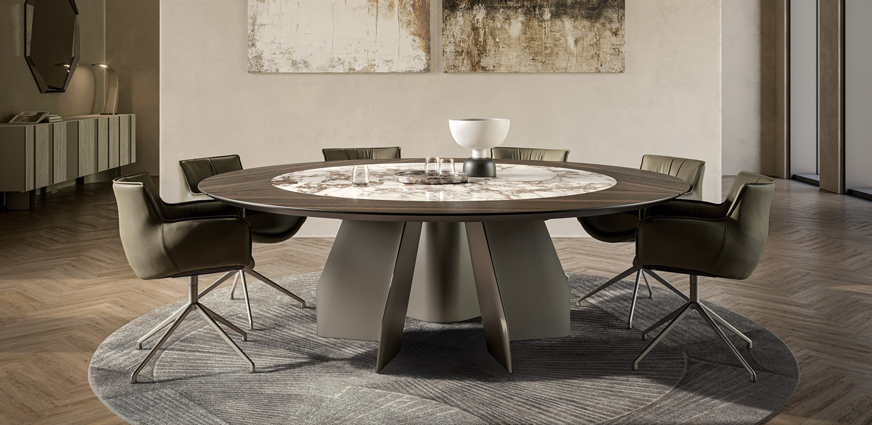
SLIDE 14 / KITCHEN DINING
KITCHEN DINING
DINING TABLE 8 SEATER | STONE MAX 1.6M, SURROUNDED BY WOODEN INLAY TO CREATE LARGER TOP
DINING TABLE 8 SEATER
Stone Max 1.6m, Surrounded by Wooden Inlay to Create Larger Top

Slide 15




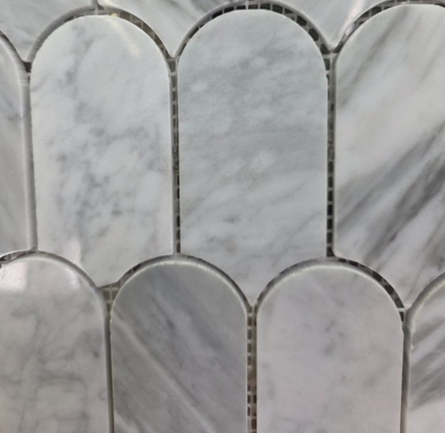
SLIDE 15 / KITCHEN DINING PALETTE
COLOUR AND FABRIC PALETTE
TABLE LEGS MUST BE STEEL POWDER COATED IN MATTE GREY OR STEEL | COMPLEMENTING BICS
CENTRE STONE
White Veined Stone (Max 1.6m)
PEBBLE TIMBER
Surrounding Wooden Inlay
MATTE GREY / STEEL
Powder Coated Table Legs
ARCH STONE TILE
Honed Marble Detail

Slide 16

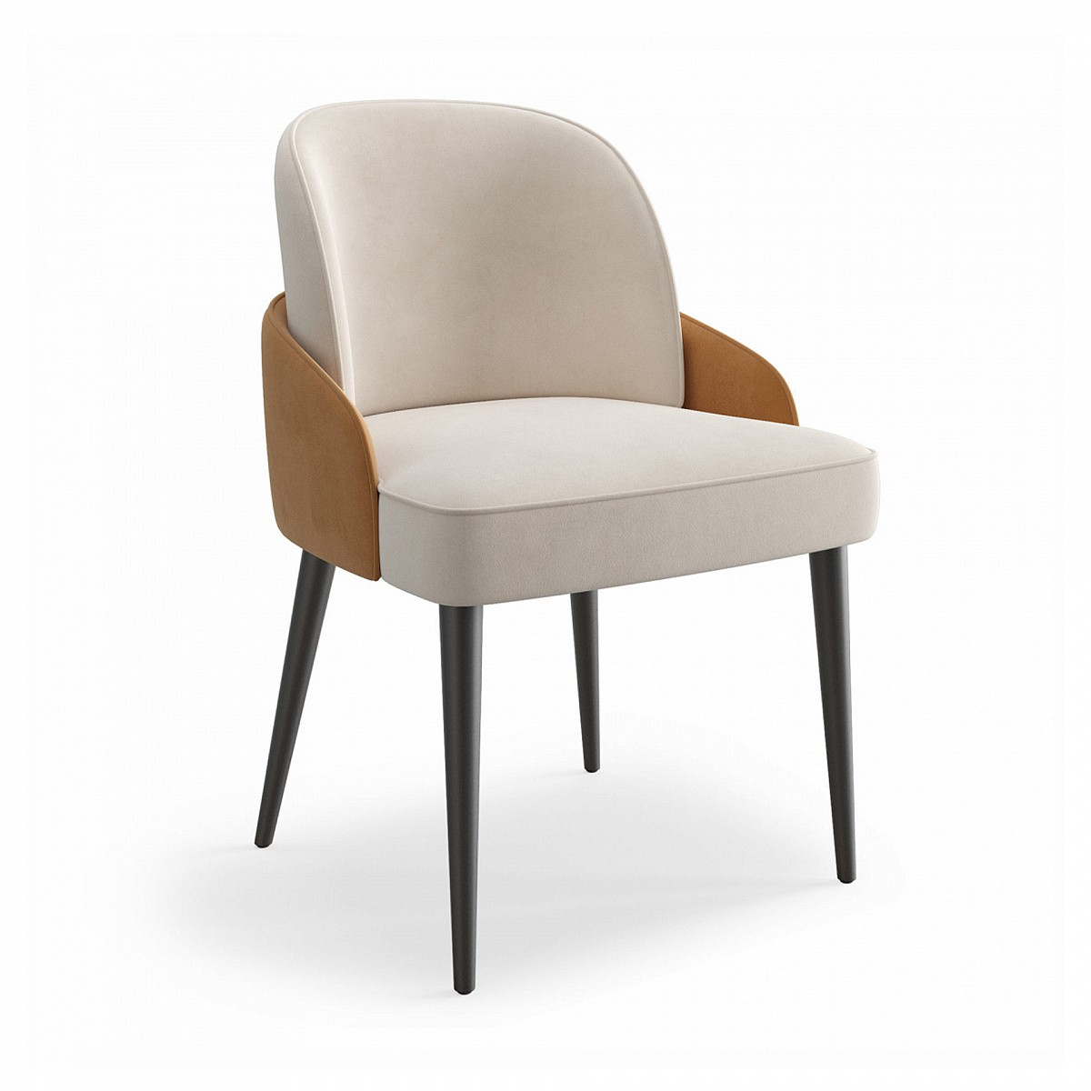
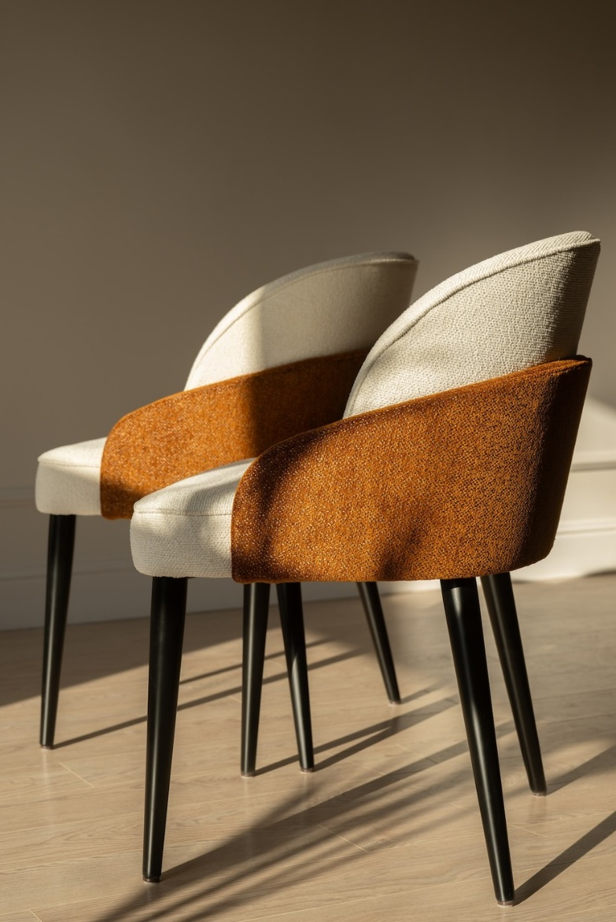
SLIDE 16 / KITCHEN DINING
KITCHEN DINING
8X TWO-TONE UPHOLSTERED DINING CHAIRS
DINING CHAIR (FRONT PROFILE)
Ivory Seat & Contrast Cognac Wing
DINING CHAIRS (REAR & SIDE PROFILE)
Rich Cognac Suede Outer Wrap

Slide 17

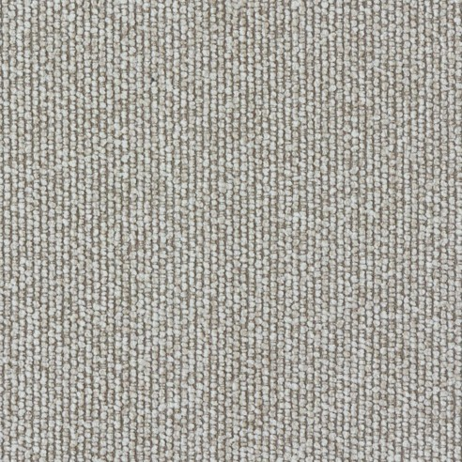

SLIDE 17 / KITCHEN DINING PALETTE
COLOUR AND FABRIC PALETTE
FABRIC FOR DINING CHAIRS
INNER SEAT FABRIC
Tactile Oatmeal Boucle Weave
OUTER WRAP FABRIC
Warm Cognac / Camel Suede

Slide 18

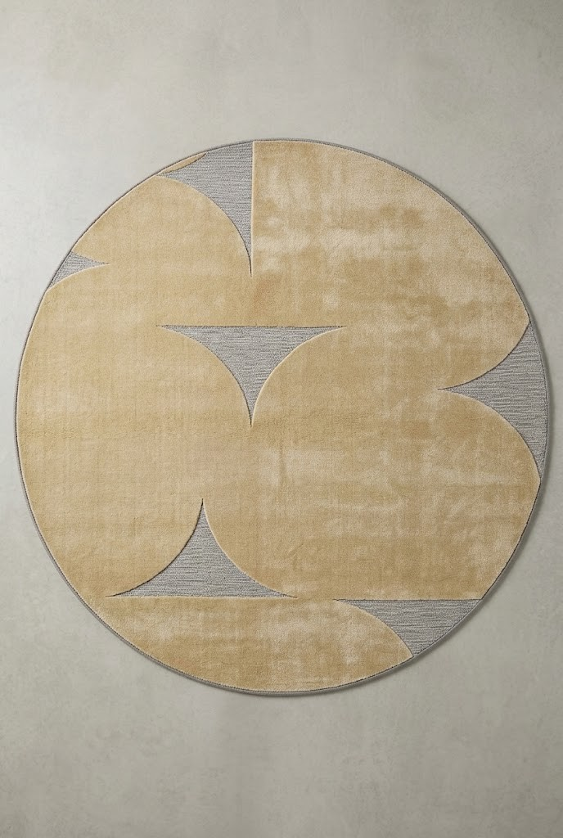
SLIDE 18 / KITCHEN DINING
KITCHEN DINING
ROUND RUG
ROUND RUG
Sculpted Champagne Gold & Silver-Grey Geometric Pile

Slide 19

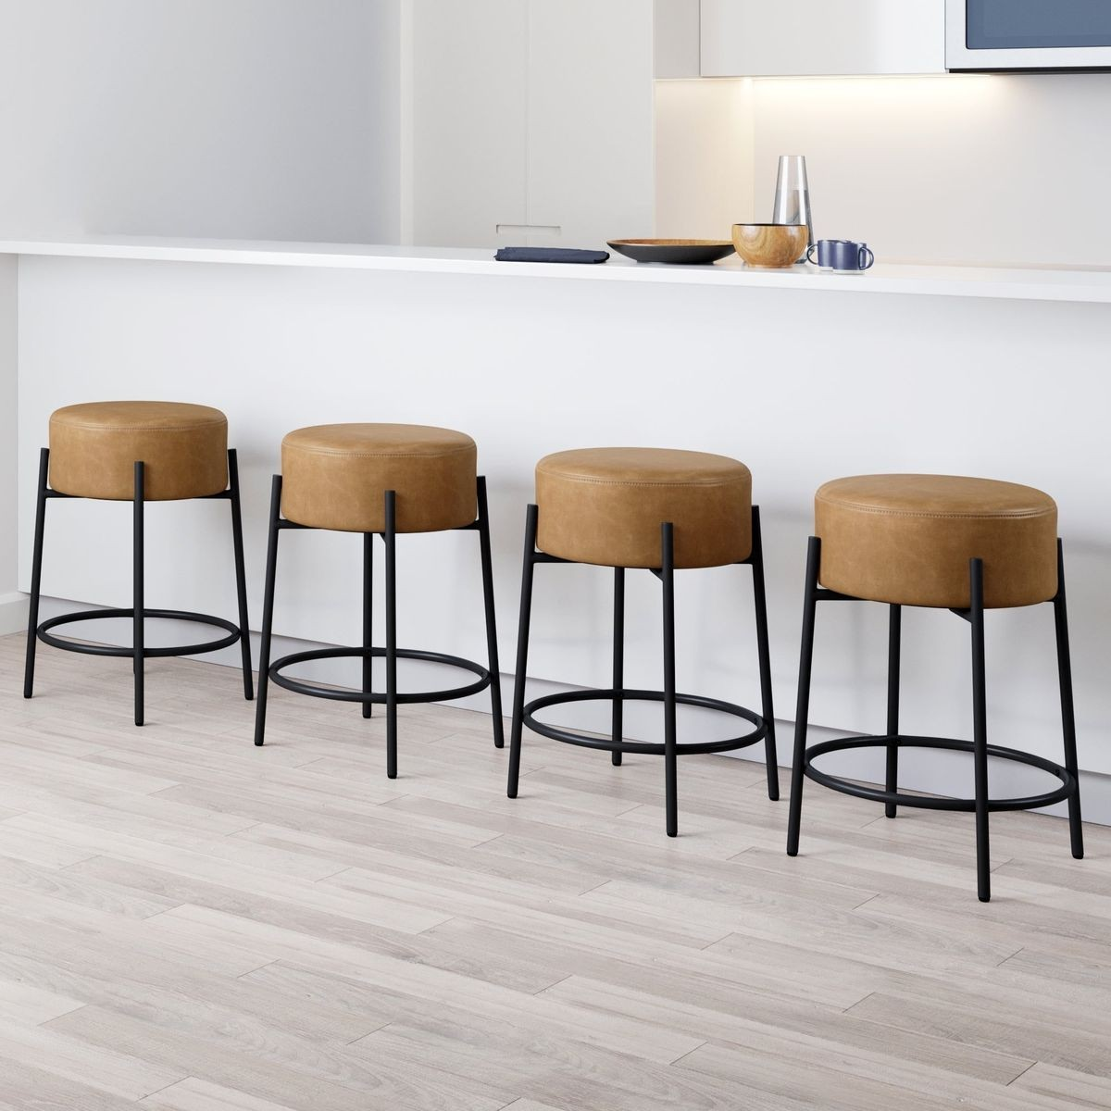
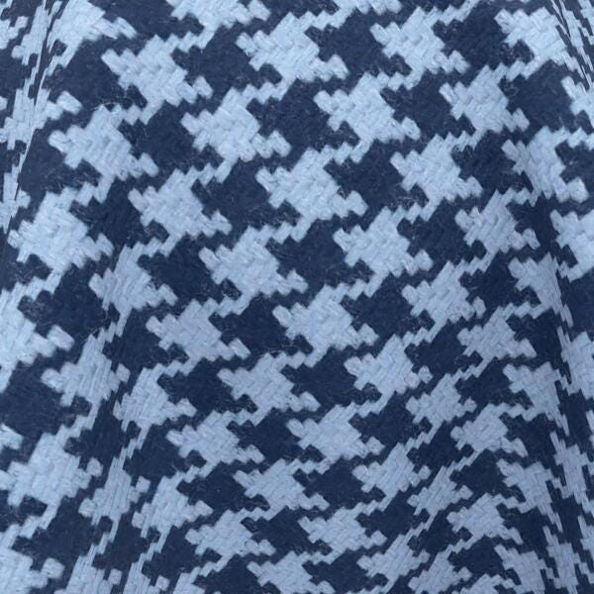
SLIDE 19 / KITCHEN DINING
KITCHEN DINING
COUNTER BAR STOOLS & FEATURE UPHOLSTERY SWATCH
COUNTER BAR STOOLS
4x Tan Upholstered Drum Bar Stools
FEATURE TEXTILE SWATCH
Woven Houndstooth Accent Fabric

Slide 20

SLIDE 20 / SPATIAL PLANNING
PROPOSED ENTRANCE LOUNGE AND TV LOUNGE LAYOUT
ARCHITECTURAL FLOOR PLAN REFERENCE
PROPOSED LAYOUT
Entrance Lounge & TV Lounge

Slide 21

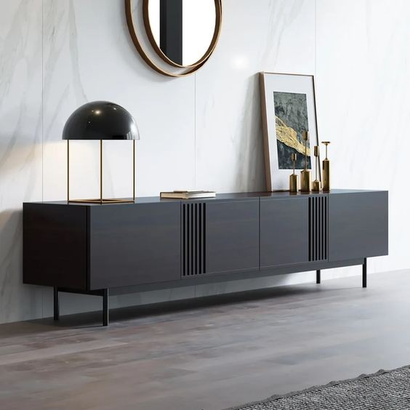

SLIDE 21 / TV LOUNGE
TV LOUNGE
LOW PLASMA STAND | STUCCO WALL BEHIND | STUCCO COLOUR
LOW PLASMA STAND
Stucco Wall Behind
STUCCO COLOUR
Warm Dove-Grey Textured Wall Finish

Slide 22

SLIDE 22 / TV LOUNGE
TV LOUNGE
PRIMARY TV LOUNGE SEATING
TV LOUNGE SOFA
Deep Textured Multi-Tone Weave

Slide 23

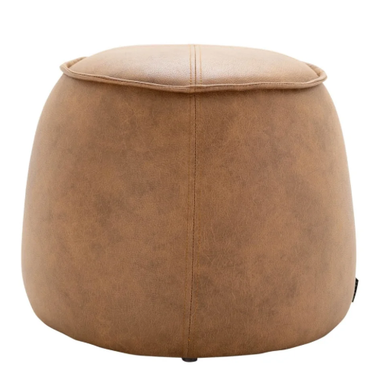
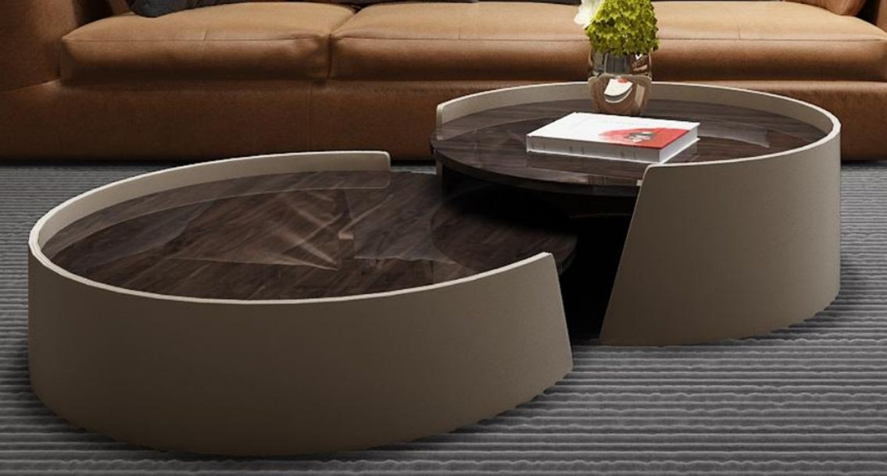
SLIDE 23 / TV LOUNGE
TV LOUNGE
BRONZE GLASS AND UPHOLSTERED SIDES NESTED COFFEE TABLE 80CM AND 50CM
NESTED COFFEE TABLE (80CM & 50CM)
Bronze Glass & Upholstered Sides
LEATHER OTTOMAN
Piped Saddle Tan Leather

Slide 24

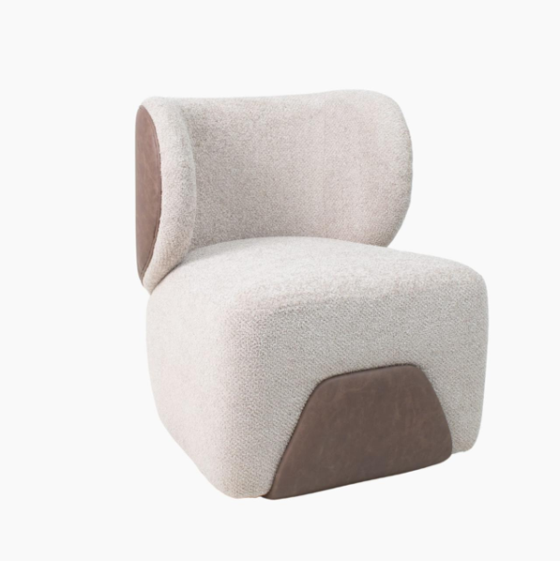
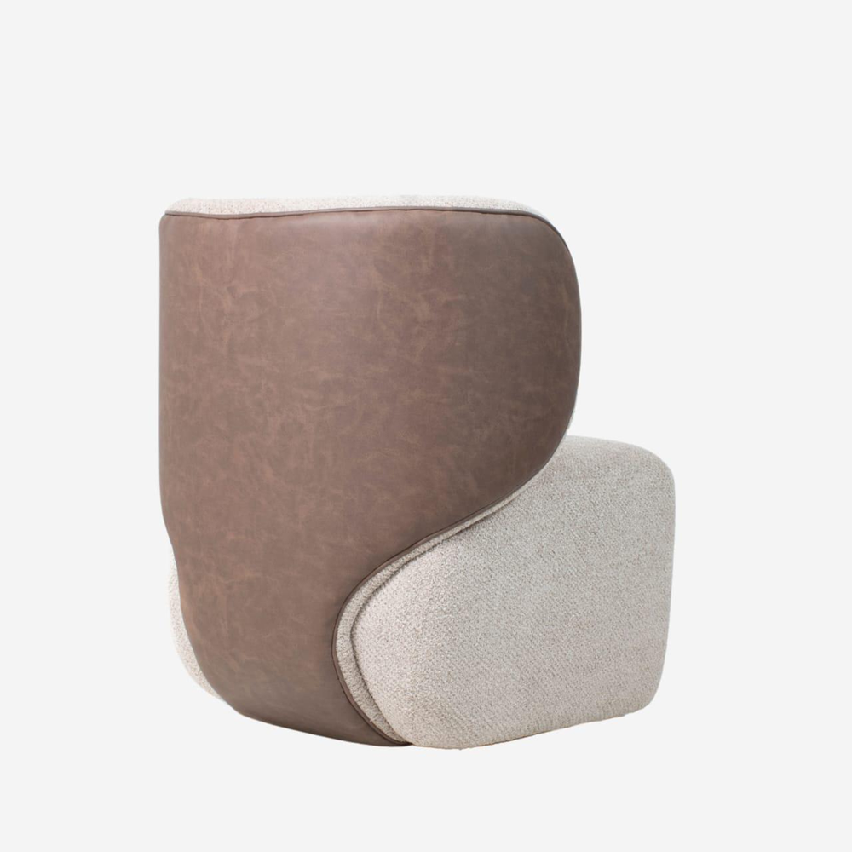
SLIDE 24 / TV LOUNGE
TV LOUNGE
SCULPTURAL TWO-TONE BOUCLE & LEATHER OCCASIONAL CHAIRS
OCCASIONAL CHAIR (FRONT VIEW)
Cream Boucle & Leather Trim
OCCASIONAL CHAIR (BACK VIEW)
Contoured Taupe Saddle Leather Wrap

Slide 25

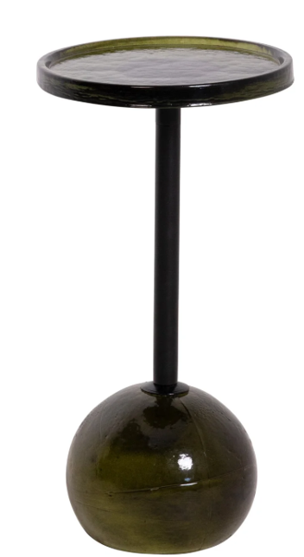
SLIDE 25 / TV LOUNGE
TV LOUNGE
ACCENT PEDESTAL SIDE TABLE
PEDESTAL SIDE TABLE
Olive Blown Glass Base & Smoked Top

Slide 26

SLIDE 26 / TV LOUNGE PALETTE
COLOUR AND FABRIC PALETTE
TV LOUNGE | BESPOKE SWATCH SELECTION
TV LOUNGE
COLOUR AND FABRIC PALETTE
Reserved placeholder slide for TV Lounge fabric, carpet, and finish swatches.

Slide 27

SLIDE 27 / TV LOUNGE PALETTE
COLOUR AND FABRIC PALETTE
TV LOUNGE | BESPOKE SWATCH SELECTION
TV LOUNGE
COLOUR AND FABRIC PALETTE
Reserved placeholder slide for TV Lounge fabric, carpet, and finish swatches.

Slide 28

SLIDE 28 / TV LOUNGE PALETTE
COLOUR AND FABRIC PALETTE
TV LOUNGE | BESPOKE SWATCH SELECTION
TV LOUNGE
COLOUR AND FABRIC PALETTE
Reserved placeholder slide for TV Lounge fabric, carpet, and finish swatches.

Slide 29

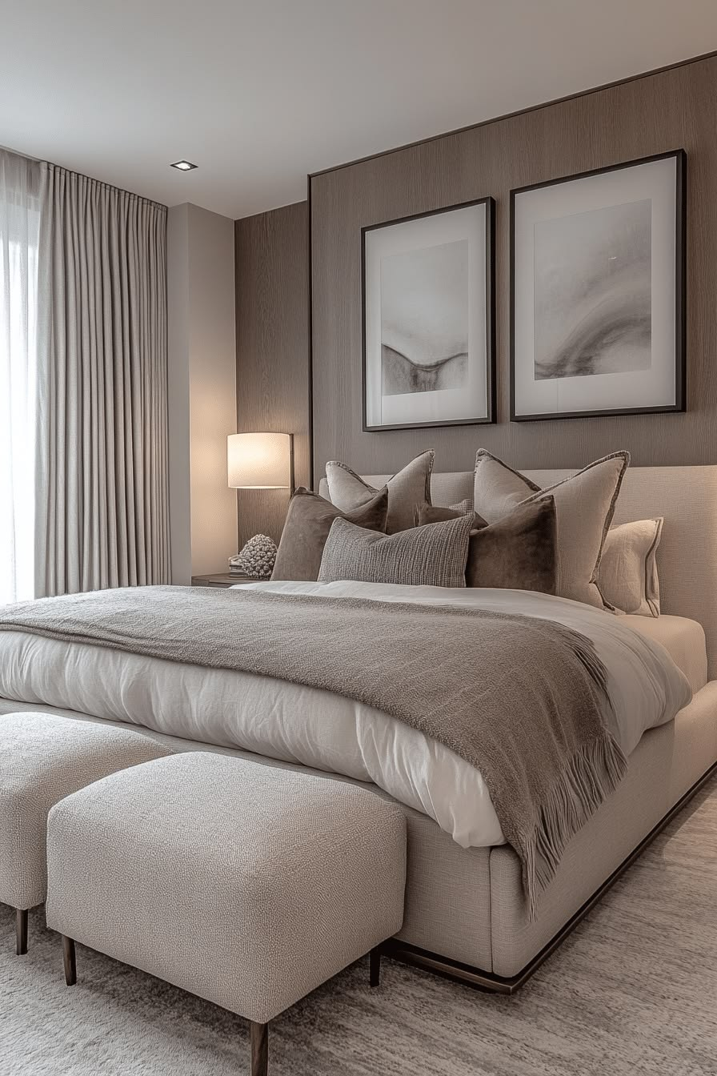
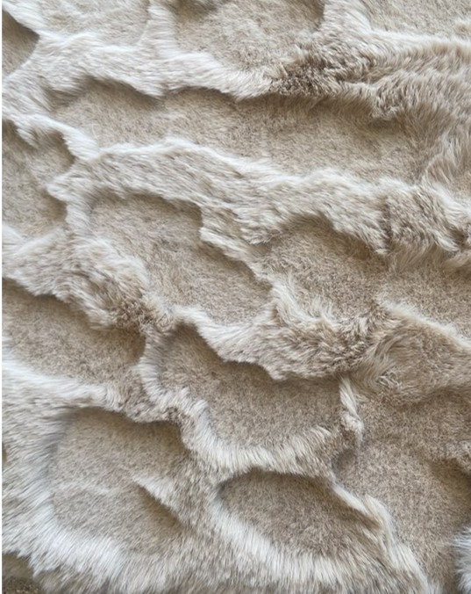
SLIDE 29 / MASTER SUITE
MASTER BEDROOM
SOFT LUXURY CARPET
MASTER BEDROOM SUITE
Tailored Upholstered Bed & Twin Ottomans
SOFT LUXURY CARPET
High-Pile Carved Organic Texture

Slide 30

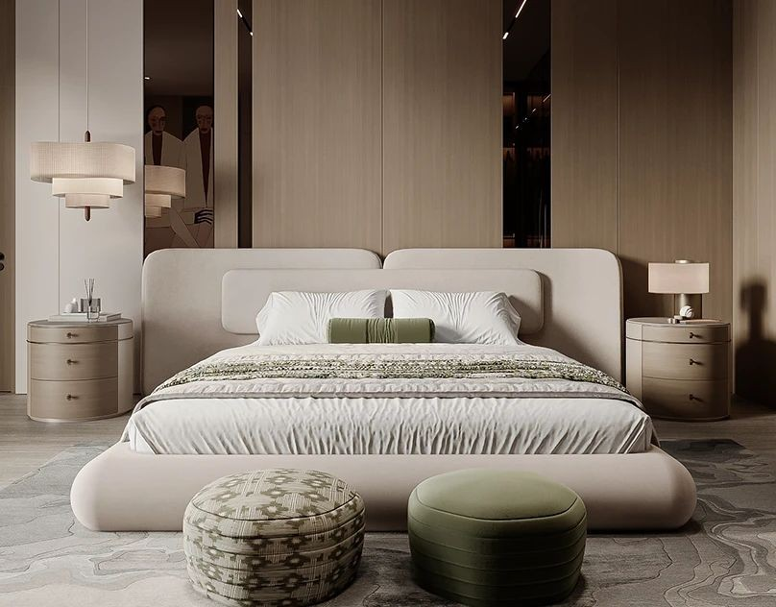
SLIDE 30 / MASTER SUITE
MASTER BEDROOM
EXTENDED HEADBOARD & CUSTOM FOOT-OF-BED POUFS
MASTER BEDROOM ELEVATION
Extended Split-Cushion Headboard & Twin Poufs

Slide 31

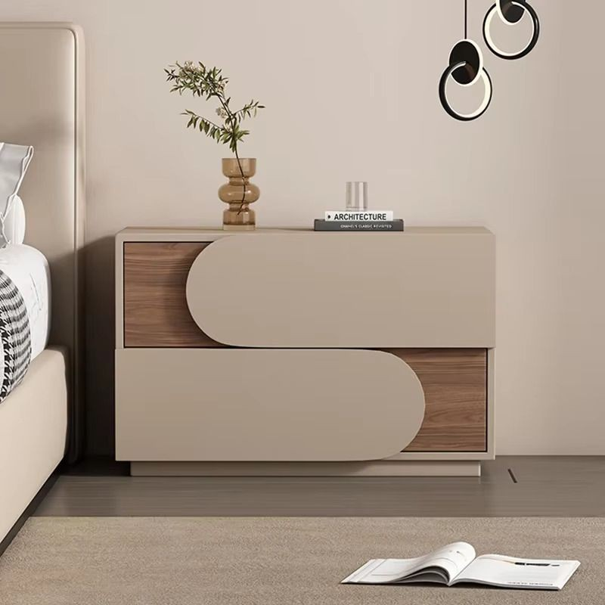
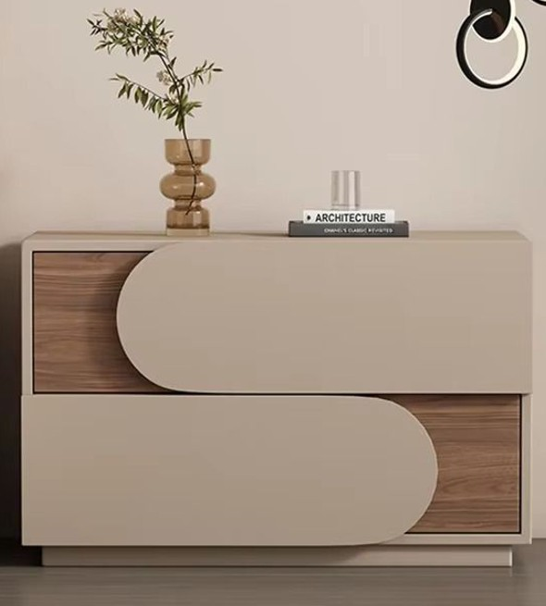
SLIDE 31 / MASTER SUITE
MASTER BEDROOM
2X NIGHT STANDS
NIGHT STAND I
Curved Taupe Lacquer & Walnut Inlay
NIGHT STAND II
Curved Taupe Lacquer & Walnut Inlay

Slide 32

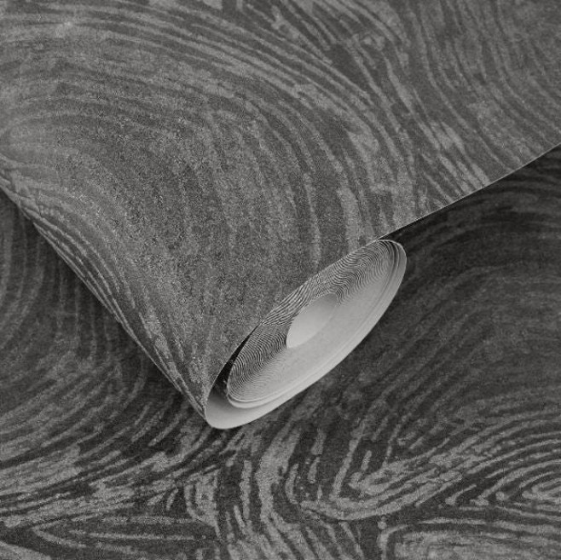
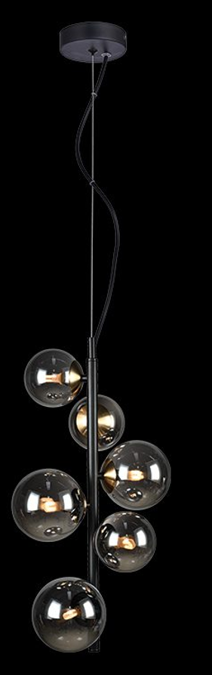
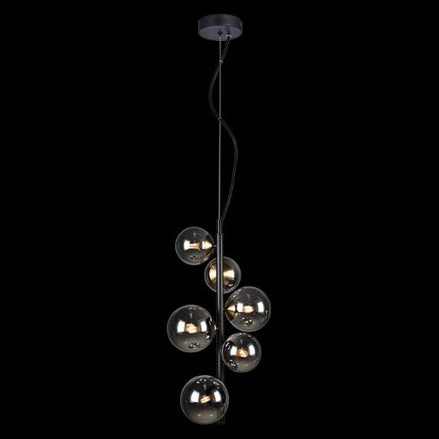
SLIDE 32 / MASTER SUITE
MASTER BEDROOM
WALLPAPER | PENDANT LIGHTING
WALLPAPER
Charcoal Organic Woodgrain Textured Wallpaper
PENDANT LIGHTING I
Smoked Glass Cluster
PENDANT LIGHTING II
Bedside Drop Pair

Slide 33

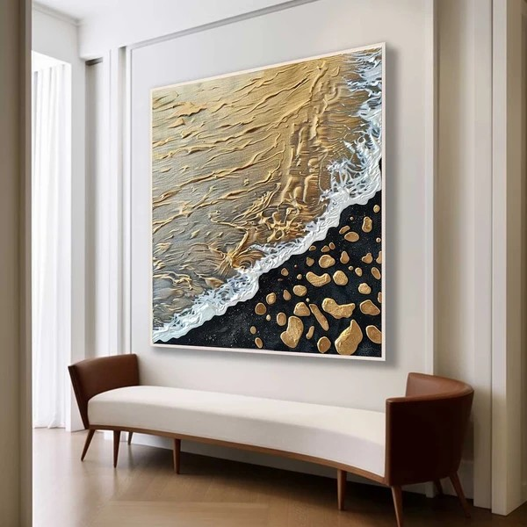
SLIDE 33 / MASTER SUITE
MASTER BEDROOM
FEATURE UPHOLSTERED BENCH & STATEMENT ARTWORK
MASTER SUITE SETTEE & STATEMENT ARTWORK
Cognac-Trimmed Bench & Gilded Canvas

Slide 34

SLIDE 34 / MASTER SUITE PALETTE
COLOUR AND FABRIC PALETTE
MASTER BEDROOM | BESPOKE SWATCH SELECTION
MASTER BEDROOM
COLOUR AND FABRIC PALETTE
Reserved placeholder slide for Master Bedroom fabric, headboard upholstery, and finish swatches.

Slide 35

SLIDE 35 / MASTER SUITE PALETTE
COLOUR AND FABRIC PALETTE
MASTER BEDROOM | BESPOKE SWATCH SELECTION
MASTER BEDROOM
COLOUR AND FABRIC PALETTE
Reserved placeholder slide for Master Bedroom fabric, headboard upholstery, and finish swatches.

Slide 36

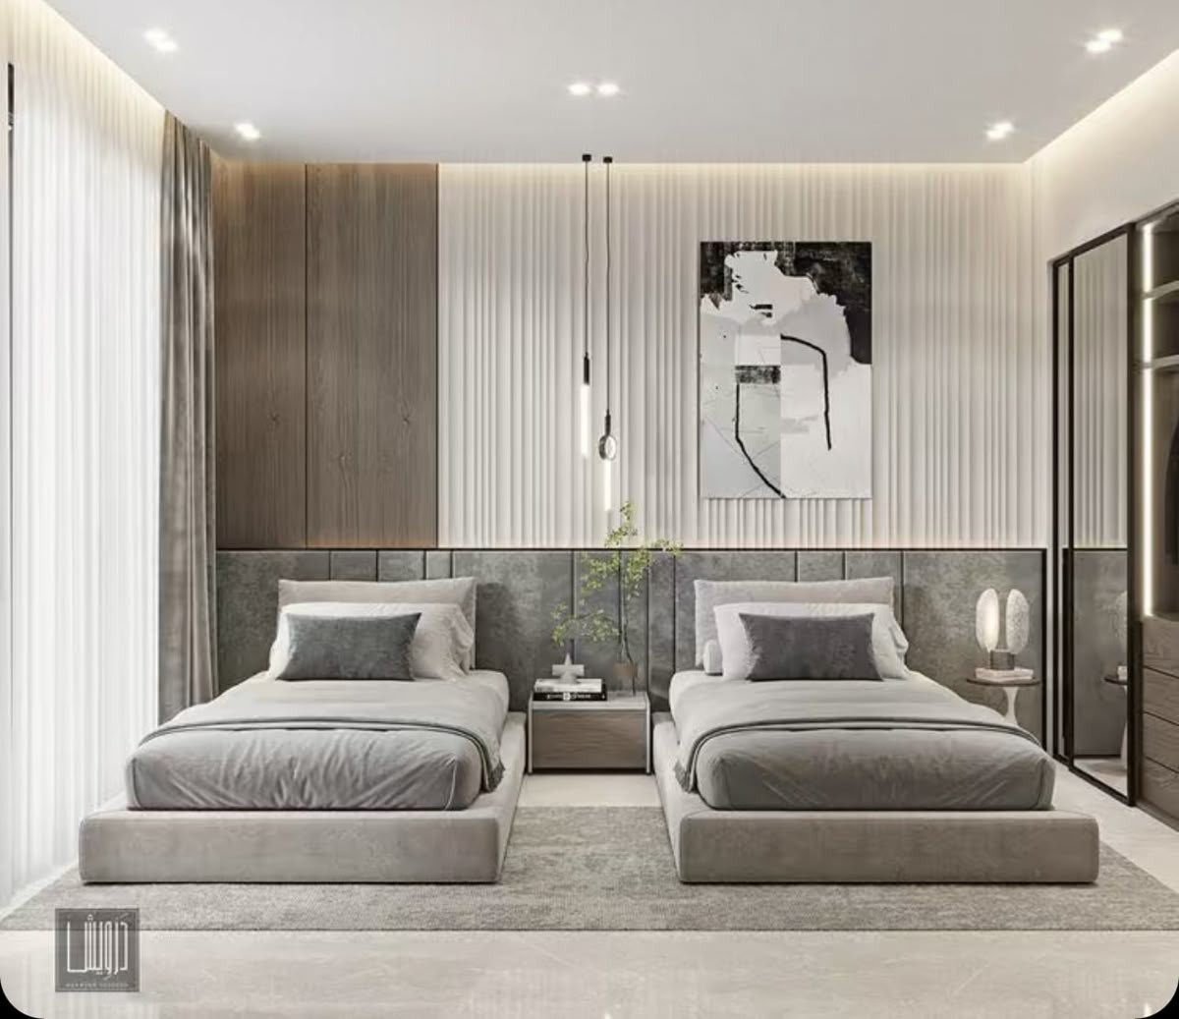
SLIDE 36 / GUEST & FAMILY SUITES
BEDROOM 1
TWIN UPHOLSTERED BEDS & FLUTED FEATURE WALL
BEDROOM 1
Twin Upholstered Platform Beds & Fluted Panelling

Slide 37

SLIDE 37 / BEDROOM 1 PALETTE
COLOUR AND FABRIC PALETTE
BEDROOM 1 | BESPOKE SWATCH SELECTION
BEDROOM 1
COLOUR AND FABRIC PALETTE
Reserved placeholder slide for Bedroom 1 fabric and finish swatches.

Slide 38

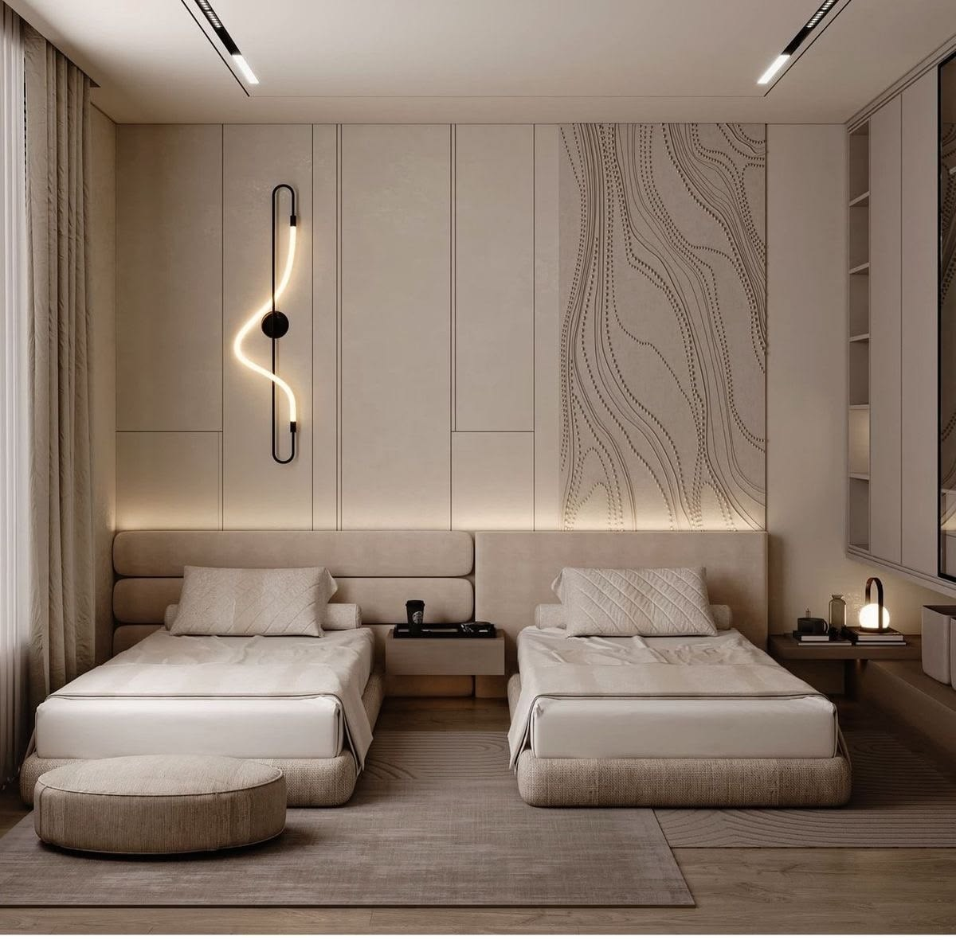
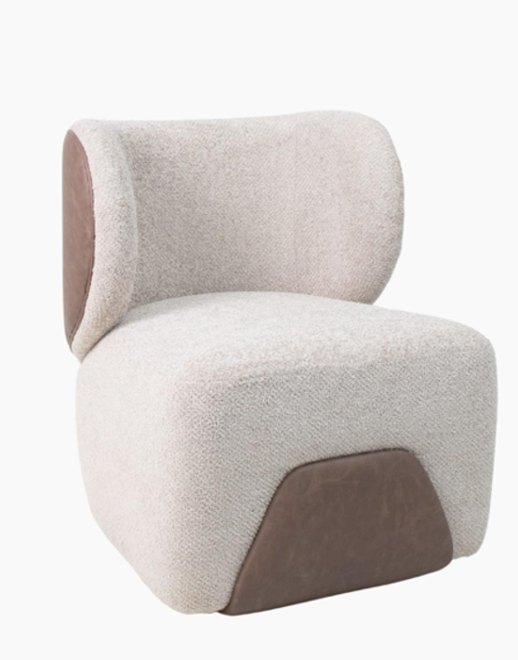
SLIDE 38 / GUEST & FAMILY SUITES
BEDROOM 2
TWIN UPHOLSTERED BEDS & SCULPTURAL BOUCLE ACCENT CHAIR
BEDROOM 2
Twin Warm Champagne Upholstered Beds
BEDROOM 2 OCCASIONAL CHAIR
Two-Tone Boucle & Taupe Leather Chair

Slide 39

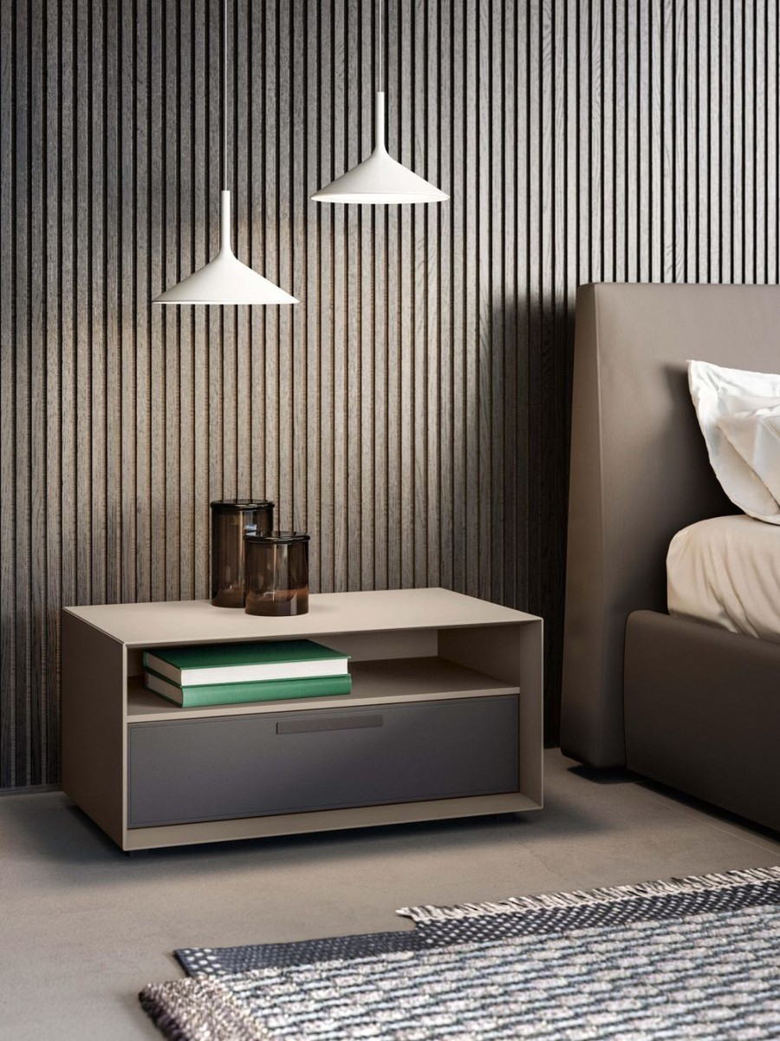
SLIDE 39 / GUEST & FAMILY SUITES
BEDROOM 1 AND BEDROOM 2
USE THE SAME NIGHTSTAND AND CARPET IN BEDROOM 1 AND BEDROOM 2
SHARED NIGHTSTAND
Used in Both Bedroom 1 and Bedroom 2
SHARED LUXURY CARPET
Used in Both Bedroom 1 and Bedroom 2

Slide 40

SLIDE 40 / BEDROOM 1 & 2 PALETTE
COLOUR AND FABRIC PALETTE
BEDROOM 1 & BEDROOM 2 | BESPOKE SWATCH SELECTION
BEDROOM 1 & BEDROOM 2
COLOUR AND FABRIC PALETTE
Reserved placeholder slide for Bedroom 1 and Bedroom 2 fabric and finish swatches.

Slide 41

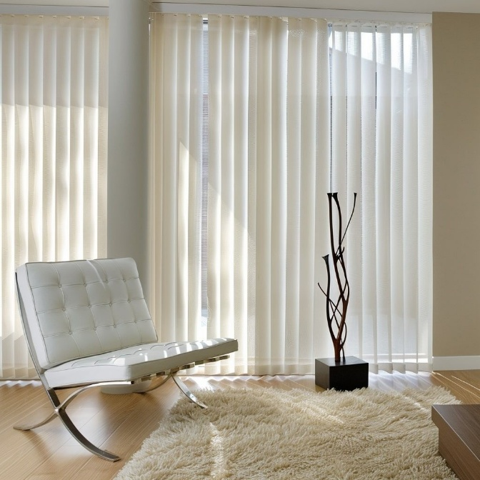
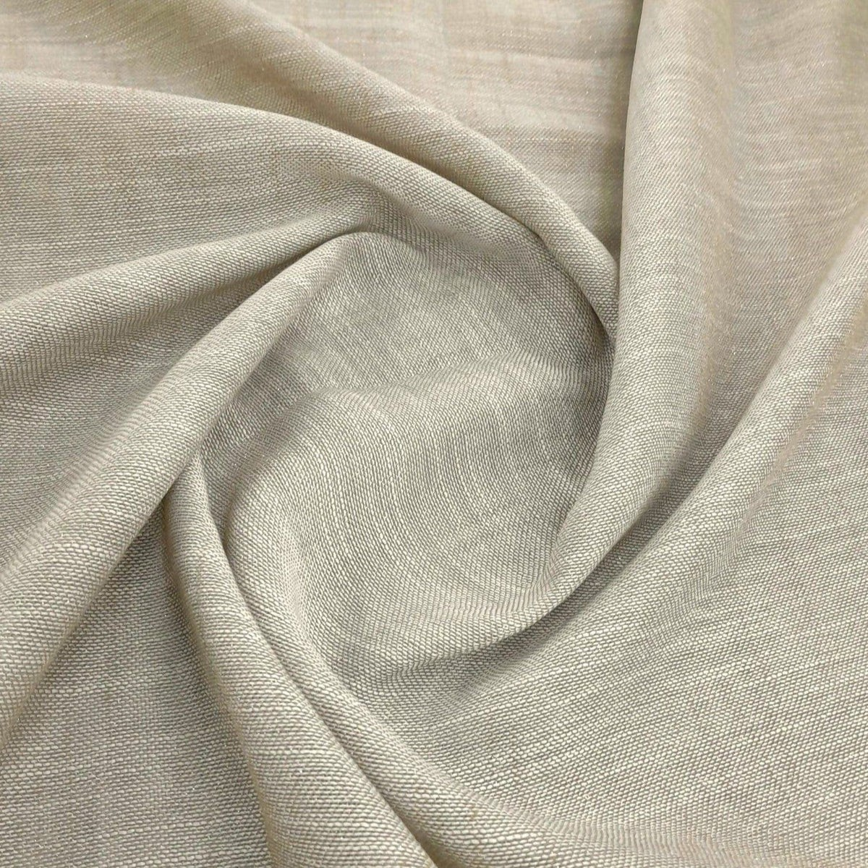

SLIDE 41 / WINDOW TREATMENTS
CURTAINING
FLOOR-TO-CEILING WAVE SHEERS & NATURAL LINEN DRAPERY
FULL-HEIGHT WAVE CURTAINING
Floor-to-Ceiling Sheer Drapery
COMPLEMENTARY SWATCH
Warm Sand & Dove Grey Pairing
PRIMARY DRAPERY TEXTILE
Natural Flowing Champagne Linen Weave

Slide 42

SLIDE 42 / EXTERIOR LIVING
OUTDOOR
DINING AREA
OUTDOOR | DINING AREA
OUTDOOR : DINING AREA
Reserved placeholder slide for Outdoor Dining Area furniture and material selections.

Slide 43

SLIDE 43 / EXTERIOR LIVING
OUTDOOR
OUTDOOR PATIO & LOUNGE
OUTDOOR
OUTDOOR
Reserved placeholder slide for Outdoor Lounge furniture and material selections.

Slide 44
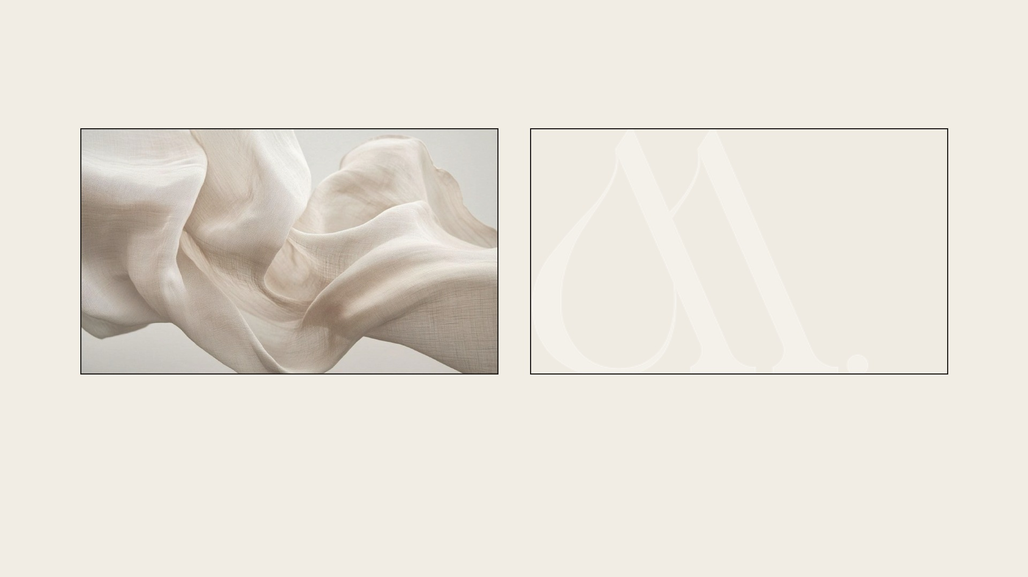
NEROSHA NAIDU
071 363 2596
MINK
WHERE LUXURY BEGINS AND NEVER ENDS....

